Slide 1



CENTRAL BOARD OF EXCISE & CUSTOMS
GST Migration: Workflow
www.cbec.gov.in www.aces.gov.in

Slide 2
What is advantage of taking registration in GST?
• Legally recognized as supplier of goods or services.
• Proper accounting of taxes paid on the input goods or services which can be utilized for payment of GST due on supply of goods or services or both by the business.
• Legally authorized to collect tax from his purchasers and pass on the credit of the taxes paid on the goods or services supplied to purchasers or recipients.

Slide 3
Sec 166. Migration of existing taxpayers to GST
Every person registered under any of the earlier laws and having a valid PAN shall be issued a certificate of registration on a provisional basis
Every person registered under an earlier law and having a Permanent Account Number issued under the Income Tax Act, 1961 (Act 43 of 1961) shall be granted registration on a provisional basis and a certificate of registration in FORM GST REG- 21, incorporating the Goods and Services Tax Identification Number (GSTIN) therein, shall be made available on the Common Portal.

Slide 4



GSTN Enrollment Process
1
2
3
Taxpayer obtains
GSTN login id and password from aces.gov.in
Taxpayer completes enrollment process on gst.gov.in
Taxpayer receives provisional GSTIN on appointed date

Slide 5
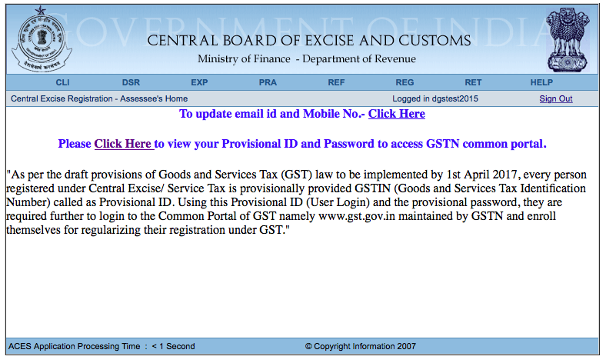
Obtaining credentials
Login to aces.gov.in to view your GSTN Provisional ID and Password

Slide 6
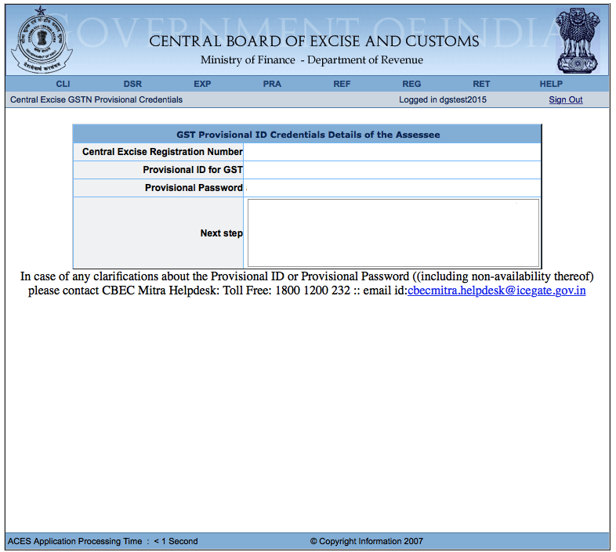
Obtaining credentials
Your ID and Password will appear here

Slide 7
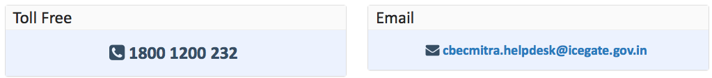
Note on Login Credentials
In some cases, your login credentials may have been shared through State VAT authorities. If you have completed the enrollment process using these credentials, you do not need to repeat the process
In some cases, your ID and Password may still be awaited from GSTN.
For assistance, contact CBEC MITRA

Slide 8
GSTN Enrollment Process
1
2
3
Taxpayer obtains
GSTN login id and password from aces.gov.in
Taxpayer completes enrollment process on gst.gov.in
Taxpayer obtains provisional GSTIN on appointed date

Slide 9
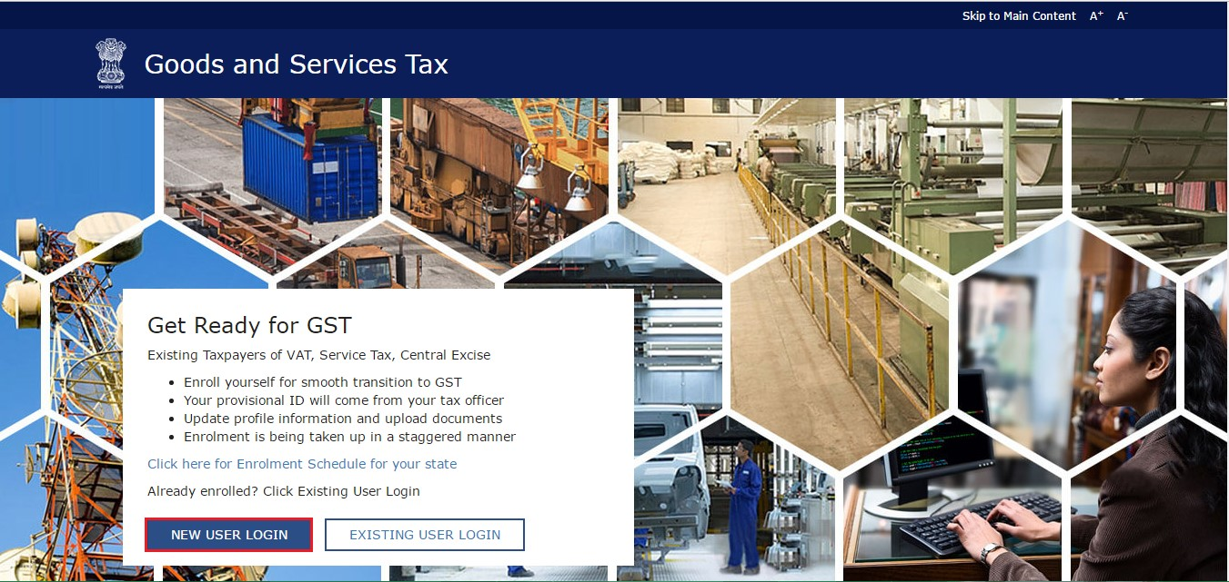
Obtaining credentials
Step 1: Go to gst.gov.in and click on “New User Login”

Slide 10
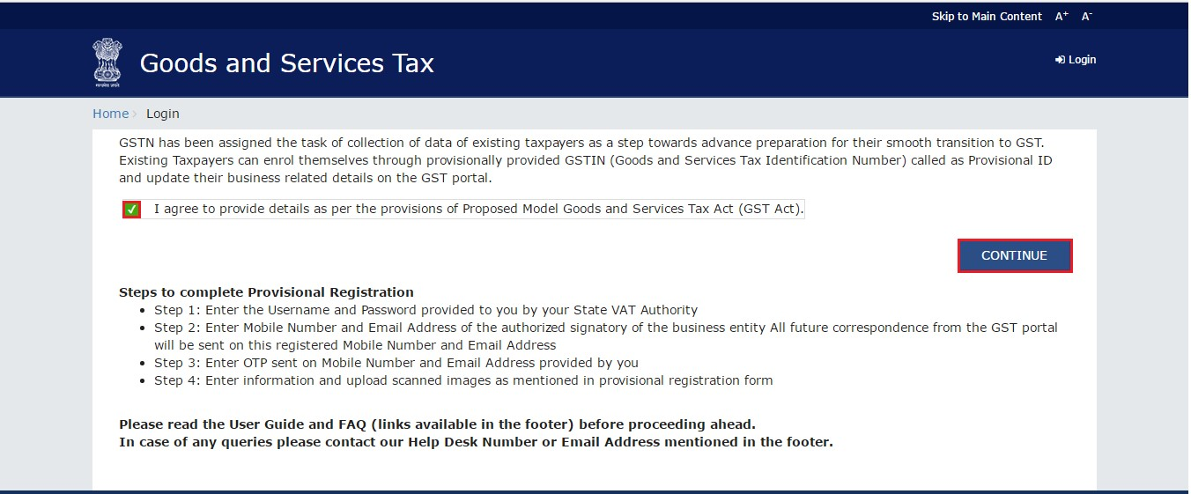
Obtaining credentials
Step 2: Read, select checkbox and hit “Continue”

Slide 11
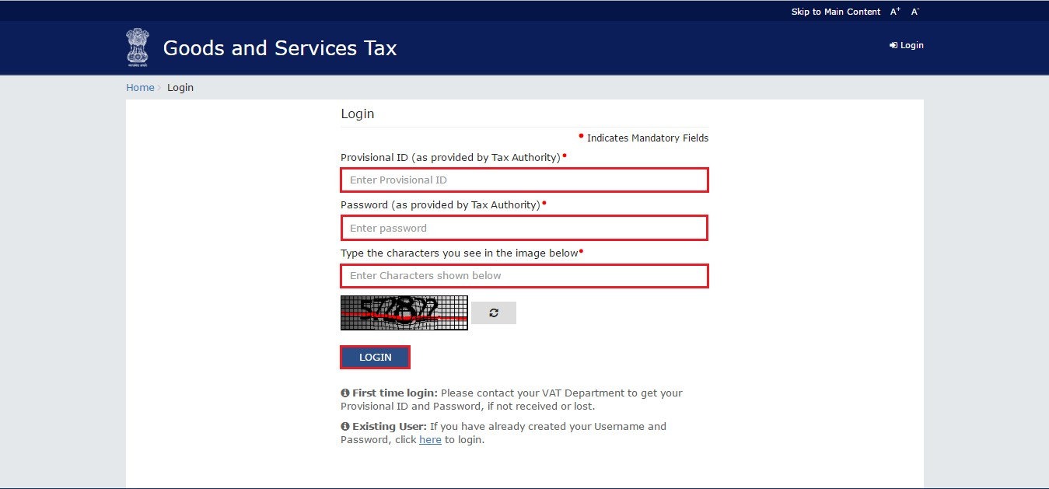
Obtaining credentials
Step 3: Enter Provisional ID and Password received in ACES website

Slide 12
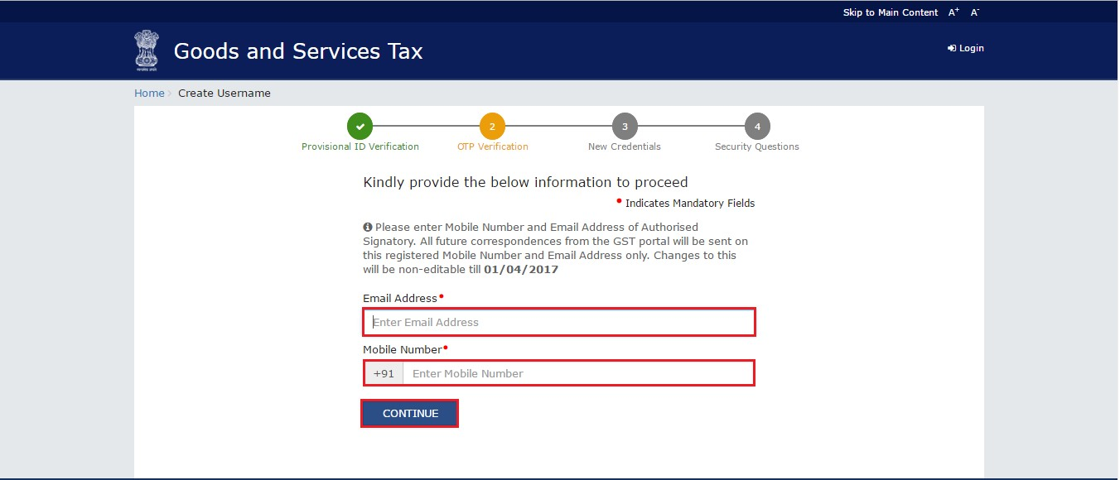
Obtaining credentials
Step 4: Enter valid email address and mobile number

Slide 13
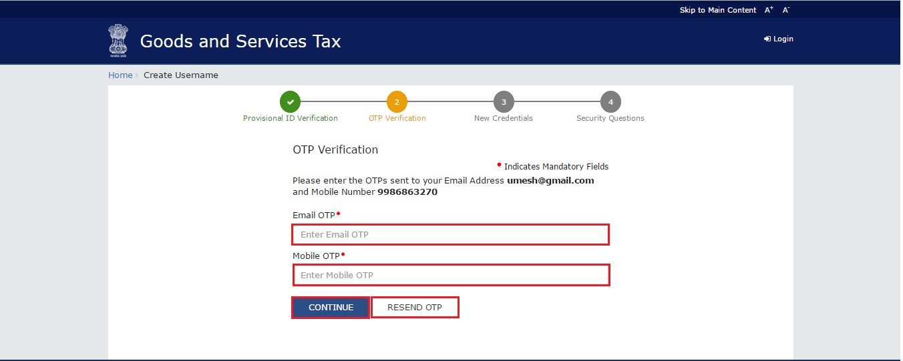
Obtaining credentials
Step 5: Verify email and mobile number using OTP

Slide 14
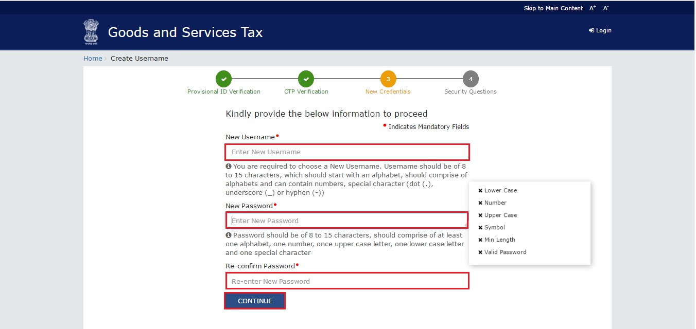
Obtaining credentials
Step 6: Select Username and Password for subsequent Login

Slide 15
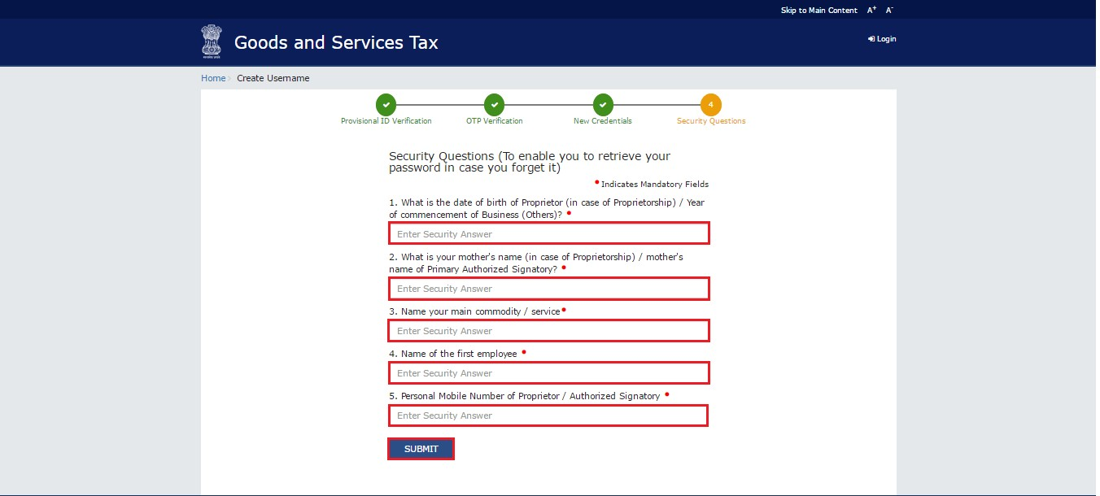
Obtaining credentials
Step 7: Answer security questions to help with password reset

Slide 16
Obtaining credentials
Step 8: Answer security questions to help with password reset

Slide 17
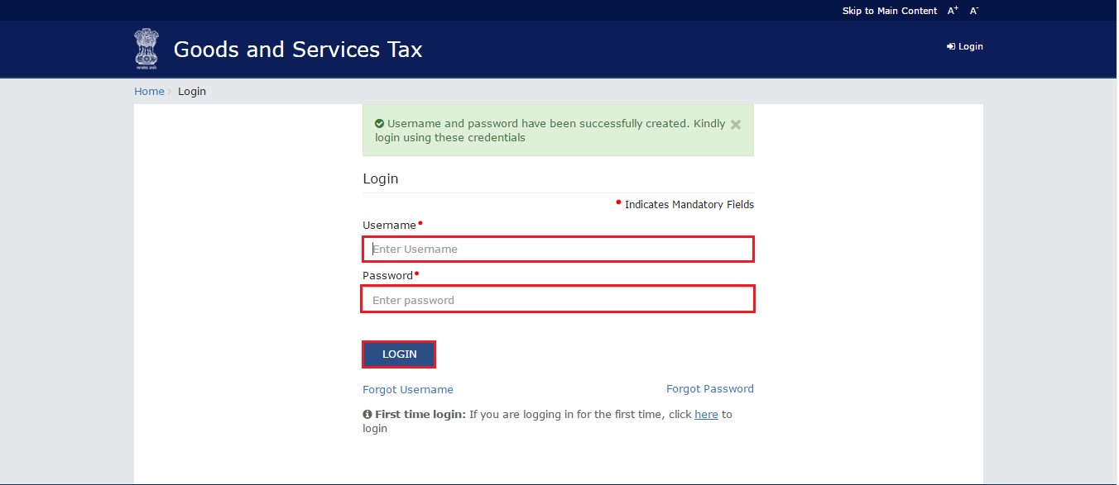
Obtaining credentials
Step 9: Login using your newly created ID and Password

Slide 18
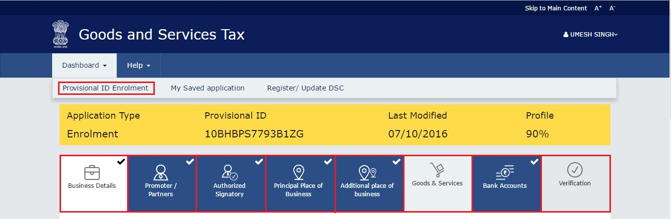
Obtaining credentials
Step 10: Complete the enrollment form, upload documents

Slide 19
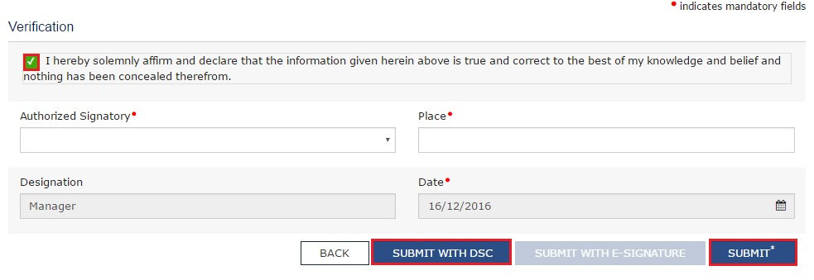
Obtaining credentials
Step 11: Verify the form and submit
Note: In case of Companies and LLPs, form has to be digitally signed.
In other cases, form may be submitted through e-signature (OTP)

Slide 20
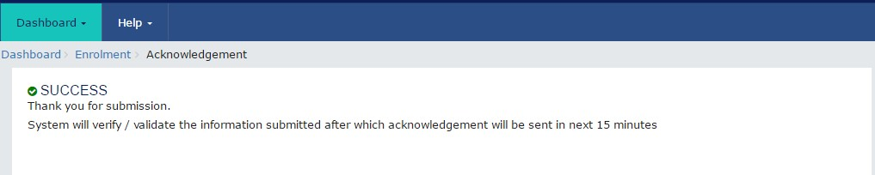
Obtaining credentials
Upon successful submission, Application Reference Number (ARN)
is received through email and SMS

Slide 21
Data and Documents Required for Enrolment
BUSINESS DETAIL | Registration certificate Partnership deed (if applicable) | PDF/JPEG(1MB)
PROMOTERS/PARTNERS | Photograph (for each) | JPEG(100KB)
AUTHORISED SIGNATORY | 1.Proof of appointment 2.Photo | PDF/JPEG(1MB) JPEG(100KB)
PRINCIPAL / ADDITIONAL PLACES OF BUSINESS | Address proof (for each) | PDF/JPEG(1MB)
BANK ACCOUNTS | Statement/First page (for each) | PDF/JPEG(1MB)

Slide 22
GSTN Portal Help
For any assistance with GSTN Common Portal, contact GSTN helpdesk:
  0124-4688999
  helpdesk@gst.gov.in
  http://tutorial.gst.gov.in

Slide 23
GSTN Enrollment Process
1
2
3
Taxpayer obtains
GSTN login id and password from aces.gov.in
Taxpayer completes enrollment process on gst.gov.in
Taxpayer obtains provisional GSTIN on appointed date

Slide 24
Relevant provision of Draft Registration Rules
Rule 14. Migration of persons registered under Earlier Law
(1) Every person registered under an earlier law and having a Permanent Account Number issued under the Income Tax Act, 1961 (Act 43 of 1961) shall be granted registration on a provisional basis and a certificate of registration in FORM GST REG- 21, incorporating the Goods and Services Tax Identification Number (GSTIN) therein, shall be made available on the Common Portal.
(2)(a) Every person who has been granted a provisional registration under subrule (1) shall submit an application electronically in FORM GST REG–20, duly signed, along with the information and documents specified in the said application, on the Common Portal either directly or through a Facilitation Centre, notified by the Board or Commissioner.
(b) The information asked for in clause (a) shall be furnished within the period specified in section 142 or within such further period as may be extended by the Board or Commissioner in this behalf.
(c) If the information and the particulars furnished in the application are found, by the proper officer, to be correct and complete, a certificate of registration in FORM GST REG-06 shall be made available to the registered taxable person electronically on the Common Portal.
(3) Where the particulars and/or information specified in sub-rule (2) have either not been furnished or not found to be correct or complete, the proper officer shall cancel the provisional registration granted under sub-rule (1) and issue an order in FORM GST REG- 22:
Provided that no provisional registration shall be cancelled as aforesaid without serving a notice to show cause in FORM GST REG-23 and without affording the person concerned a reasonable opportunity of being heard.
(4) Every person registered under any of the earlier laws, who is not liable to be registered under the Act may, at his option, file electronically an application in FORM GST REG-24 at the Common Portal for cancellation of the registration granted provisionally to him and the proper officer shall, after conducting such enquiry as deemed fit, cancel the said provisional registration.

Slide 25
Migration process at a glance
CBEC provides assessee information to GSTN which generates provisional ID and password
The provisional ID and password is made available to assessee through ACES using which assessee logs in to GSTN portal
Assessee submits GST REG 20 and uploads documents
ARN is generated and status is shown as migrated
REG 21 is generated on appointed date and is valid for 6 months.
After veification by tax authority, GSTIN is issued –REG 6

Slide 26
HELPLINE
You may visit www.cbec.gov.in or www.aces.gov.in to know more about the process of migration to GST.
In case of any difficulty or query, please contact your jurisdictional Central Excise/Service Tax officers or call the following helpdesk numbers:
CBEC : 1800-1200-232
GSTN: 0124 – 4688999
You can also send us mail at cbecmitra.helpdesk@icegate.gov.in.

Slide 27
THANK YOU

